Slide 1
In the game of Tetris
Nguyễn Thanh Châu – B19DCCN096

Slide 2
Table of contents
01
02
03
04
05
History
Tetriminoes
GA
Lịch sử Tetris
Đi sâu vào trò chơi
Giới thiệu về Genetics Algorithm
Combined
Implementation
Khả năng vận dụng GA vào game Tetris
Một ví dụ đơn giản

Slide 3

01
History
Lịch sử Tetris

Slide 4
History
Who created Tetris?
Alexey Pajitnov, a Russian computer programmer, created Tetris in 1984.
When was Tetris first released?
Tetris was first released in the Soviet Union in 1984.
How did Tetris become so popular?
Tetris became so popular because it is a simple and addictive game that can be played by people of all ages. It is also a very portable game that can be played on a variety of devices.

Slide 5
-Alexey Pajitnov, creator of Tetris
“Tetris is a game about finding order in chaos.”

Slide 6
105,300,000,000
Games have been played since 1984.

Slide 7
02
Tetrimioes
Đi sâu vào trò chơi

Slide 8
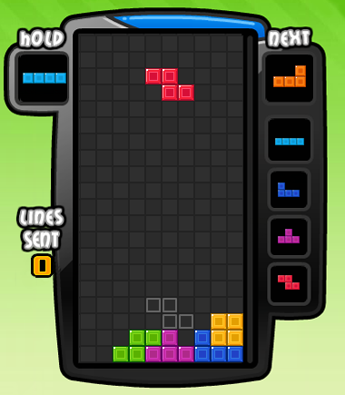
The game is played on a 10x20 grid.
The player controls a falling block, which can be rotated and moved left or right.

Slide 9
The game is played on a 10x20 grid.
There are seven different types of blocks in Tetris: I, O, L, J, S, Z, and T. Each block has a different shape and size.

Slide 10
03
GA
Genetics Algorithm

Slide 11
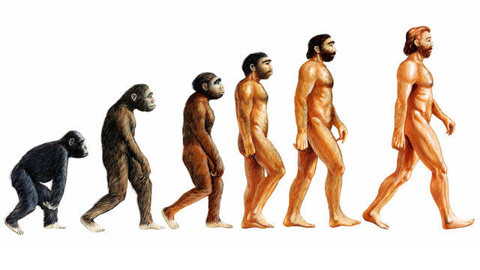
What is “genetic”?

Slide 12
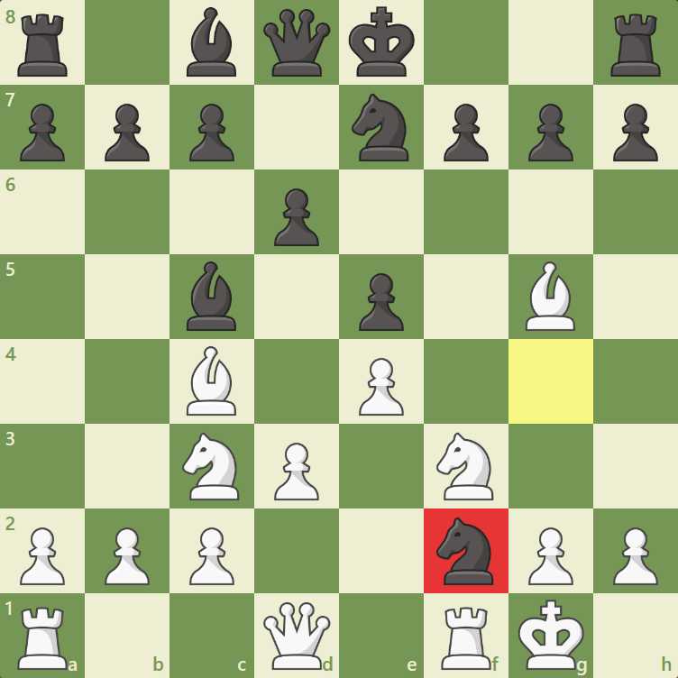

Slide 13
Aspects
1
Fitness score
The measurement of the Agent's performance
2
Selection
Filters evolving individuals and puts them into the next generation of Agents for reproduction.
3
Crossover/Recombination
The process of exchanging features between genes of the father and mother

Slide 14
Aspects
4
Offspring
The product of the above exchange process
5
Mutation
Randomly changing an individual’s genes leads to a breakthrough change in its characteristics. This can be advantageous or harmful.
6
Termination
Time to stop our algorithm.

Slide 15
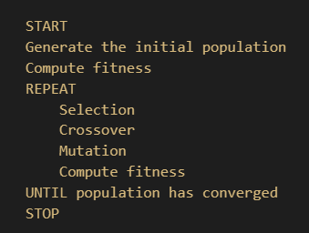
Pseudocode

Slide 16
04
Combined
Khả năng vận dụng GA vào game Tetris

Slide 17
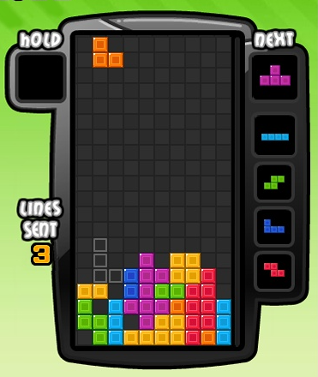
Combined
There are many ways to choose traits for our genes. Here is an example that I used:
The height of the grid.
The number of lines you will clear.
The number of holes in the grid.
The bumpiness between two consecutive columns.
And the most important part is: we should keep them between -1 and 1.

Slide 18
Our results

Slide 19
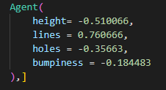
The best genes so far.

Slide 20
05
Implementation
Triển khai

Slide 21
Implementation
1
2
3
Current situation
Assets
Wrapper
Agent
We need to rebuild our game Tetris from scratch, as there aren’t many Tetris environments on the Internet, and most of them are not usable.
Sounds and drawings.
Our game environment
Our AI agent.
Problems

Slide 22
Assets and Enviroment: Not available. But I can provide some info.

Slide 23
Assets and Enviroment
1
Assets
I used Pygame and SVG images. Sounds are downloaded from the internet.
2
Environment
I used pandas, numpy and gym. It works like and OpenAI-wrapper environment.

Slide 24
Agent
1
Tactics
It will search for all available moves, which means it can rotate to find the best move.
2
Fitness score
Depends on the given genes.

Slide 25
Agent
Options when training our agent:
The mutation rate is 10%.
The population is 20.
The number of epochs is 20 (optional).
Data is saved to a csv file.

Slide 26
Thanks!
Do you have any questions?

